Slide 1
Diabetic Retinopathy Detection by means of Deep Learning

Slide 2
ABSTRACT
Diabetic Retinopathy (DR) is a complication caused by diabetes that affects the human eye. It is caused by the mutilation of the blood vessels of the light-sensitive tissue at the back of the human retina. It’s the most recurrent cause of blindness in the working-age group of people and is highly likely when diabetes is poorly controlled. Although, methods to detect Diabetic Retinopathy exist, they involve manual examination of the retinal image by an Ophthalmologist. The Proposed approach of DR detection aims to detect the complication in an automated manner using Deep Learning.

Slide 3
EXISTING SYSTEM
Enrique Carrera et al in their paper proposed a technique based on SVM to help diagnose diabetic retinopathy in advance. In this approach, an initial preprocessing stage segregates the blood vessels, microaneurysms and hard exudates to extract features to be used with SVM. The model tested on the STARE dataset resulted in a sensitivity of 94.6%.

Slide 4
The implementation proposed by Mohamed Chetoui et al has introduced the use of Local Energy based Shape Histogram (LESH) and Local Ternary Pattern (LTP) which outperforms the LBP extracted features. This model achieved an accuracy of 90.4% on MESSIDOR database which contains 1200 images.

Slide 5
Martina Melinscak et al implemented a deep convolutional neural network to segment blood vessels. The model was made up of 10 layers which achieved an accuracy of 94% on the publicly available DRIVE dataset.

Slide 6
DISADVANTAGES OF EXISTING SYSTEM
The existing process to screen DR is time-consuming and is hampered by the lack of trained ophthalmologists. It involves dilating the eye to widen the pupil, performing fluorescein angiography, using a special camera to capture an image of the retina and examination by the clinician.
Moreover, in rural regions where the number of diabetic patients is comparatively high, the wanting of trained clinicians poses a huge problem.
Mild Non-Proliferative DR is very difficult to detect as the symptoms include slowing of retinal blood flow, increased leukocytes adhesion and loss of retinal pericytes.

Slide 7
PROPOSED SYSTEM
In this proposed system, we propose an automatic deep-learning-based method for stage detection of diabetic retinopathy by single photography of the human fundus. The presented method can be used as a screening method for early detection of diabetic retinopathy with sensitivity. The model presented was developed using Keras with TensorFlow backend for Python. The proposed system is implemented using Inception V3 architecture.

Slide 8
The dataset used is in the proposed is freely available to download from internet sources. All images are taken of different people, using different cameras, and of different sizes. This data is very noisy, hence multiple preprocessing steps were applied to get all images in a format suitable for training.

Slide 9
ADVANTAGES OF PROPOSED SYSTEM
Based on the experiment, a general deep learning model for detecting Diabetic Retinopathy was developed, and it could be used with all databases.
We provided a simple method of addressing the imbalance of DR databases, and this method can be used with other medical images.
Achieved an accuracy score of 95% which is better than the existing system models.

Slide 10
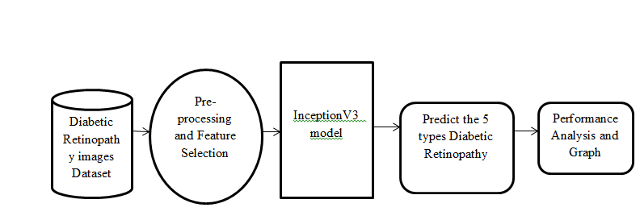
SYSTEM ARCHITECTURE

Slide 11
HARDWARE REQUIREMENTS
System : Pentium i3 Processor.
Hard Disk : 500 GB.
Monitor : 15’’ LED
Input Devices : Keyboard, Mouse
Ram : 4 GB

Slide 12
SOFTWARE REQUIREMENTS
Operating system : Windows 10.
Coding Language : Python
Web Framework : Flask

Slide 13
REFERENCE
Sumit Thorat, Akshay Chavan, Pratik Sawant, Sharvika Kulkarni, Nitin Sisodiya, Prof. Anand Kolapkar, “Diabetic Retinopathy Detection by means of Deep Learning”, IEEE Conference, 2021.

